Slide 1
FLIGHT PRICE PREDICTION
Presented By
Dipesh Ramesh Limaje

Slide 2
Problem Statement
Anyone who has booked a flight ticket knows how unexpectedly the prices vary. The cheapest available ticket on a given flight gets more and less expensive over time. This usually happens as an attempt to maximize revenue based on –
Time of purchase patterns (making sure last-minute purchases are expensive)
2. Keeping the flight as full as they want it (raising prices on a flight that is filling up in order to reduce sales and hold back inventory for those expensive last-minute expensive purchases)
So, you have to work on a project where you collect data on flight fares with other features and work to make a model to predict the fares of flights.

Slide 3
EDA Steps
1) Check data shape(Num. of Rows, Num. of Columns)
(1634,14)
So there are 1634 Rows and 14 Columns.
2) Check each data type of columns and missing Values
So from data.info, we get all the information related to data types, and after observing all data types we find price have datatype of object so we treat the datatype of price column.
And after observing all values from columns there are no missing values.
3) Change the data types
After all observations, the data looks good we don't need to change any of the data types.

Slide 4
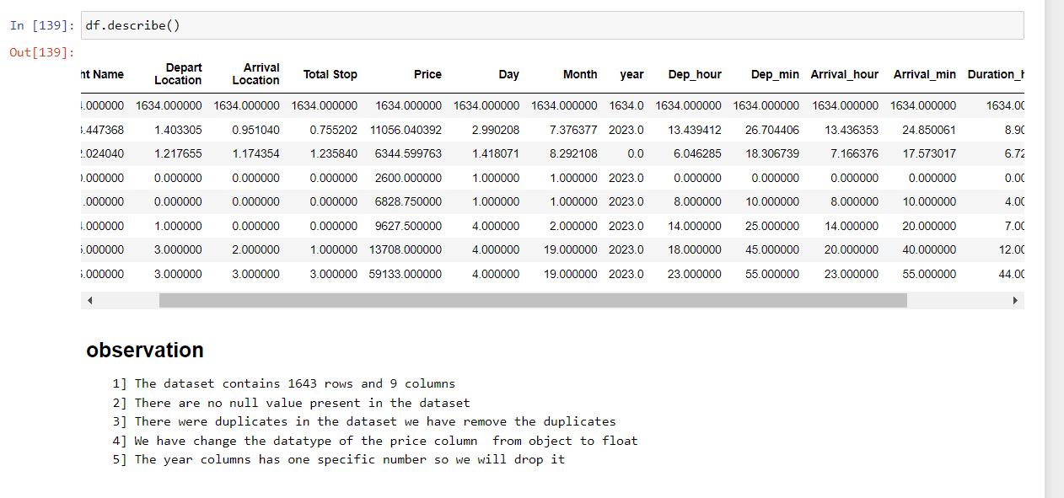
4) Summary Statistics
From this, we can see the data distribution that you have for each and determine whether there are outliers or not.
5) Check Duplicate values
We have check the duplicates and we find some duplicates so we drop all the duplicates.

Slide 5
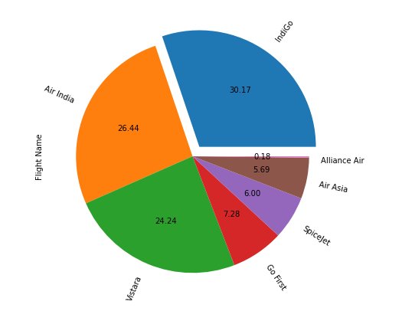
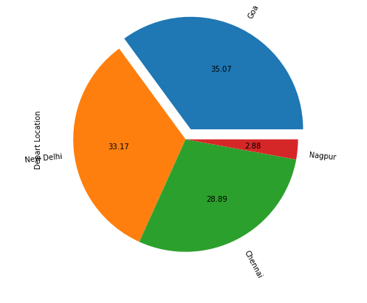
EDA and Visualization
From the above pie chart, we observe that we have 7 different airlines and the indigo count is almost 30.17% followed by air India at 26.44% and the least is Alliance Air which is 0.18%.
From the above pie chart, we have 4 different Departure locations and the count of people departing from goa is the most which are 35.07% followed by New Delhi is 33.17% followed by Chennai is 28.89% and the least is Nagpur which is 2.88%.

Slide 6
From the above pie chart, we have 4 different Arrival locations and the count of people who arrived from Mumbai is the most which are 57.22% followed by NewDelhi which is 23.81% followed by Pune is 14.26% and the least is Nagpur which is 4.71%.
From the above pie chart, we observe the count of the flight with one stop is more which is 69.22% followed by non-stop flights with 22.34% followed by 2 stops and 3 stops which is 8.36% and 0.06%.

Slide 7
From the above line chart we observe as days go by the price of the flight ticket goes on increasing
From the above line chart we observe as months go the price of flight tickets decreases (Advance Booking).

Slide 8
From the above bar chart, we observe the flight ticket price is high for Vistara and Air India airlines.
From the above bar chart, we observe the flight which has 2 stops has had a higher price.

Slide 9
From the above graph, we observe the time vs price of the night flight has more price as compared to day-time flights

Slide 10
The Set Of Assumptions Related To The Problem Under Consideration
1] For this particular problem I have dropped the duplicate value which I have found.
2] For this particular problem I have assumed that the Maximum VIF should be 5, if any of the features has a VIF which is greater than 5 we should drop that feature.

Slide 11
Steps
1) First we look for null values and there was not any null present
2)Then I identified duplicates and I have dropped duplicates
3) Then we Performed EDA and wrote all observations for each graph
4)Then I dropped unnecessary columns
5)Then applied a label encoder to the categorical columns
6)Then also plotted the Distribution plot and regression plot
7)Then plotted boxplot to remove outliers
8)Then treated outliers with the Z-score method
9)Then scaled data and Also check for VIF
10)Then find the co-relation between feature and label by the CORR method
11)Then we selected all the features except Day and Month because VIF was greater than 5
12)Then I created 4 models that are Gradient Boosting Regressor, Random Forest Regressor, linear Regressor model, and Ada Boosting regressor model with hyperparameter tuning for all 4 models.
13)At last I selected the best model according to their Hyperparameter score and Training(R2) and testing score(R2)

Slide 12
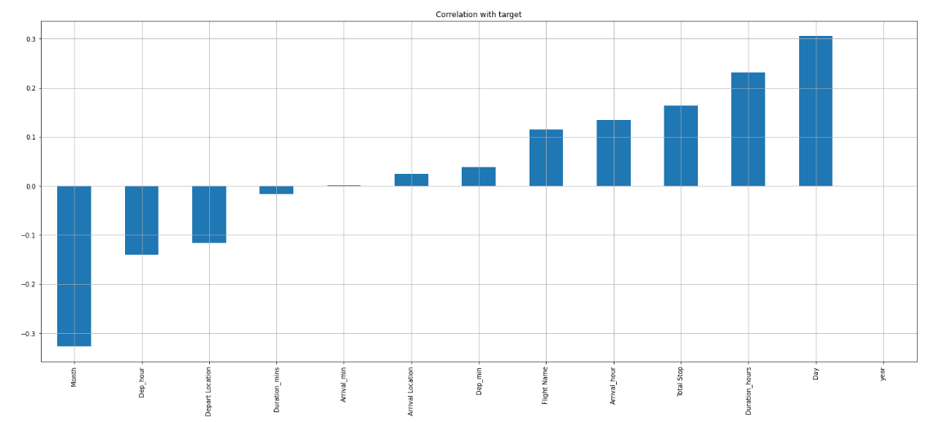
These are all the features that are positively co-related to the label and Negatively Co-related to the Label

Slide 13
Testing of Identified Approaches (Algorithms)
LR (Linear Regression Model)
GBDT (Gradient Boosting Regressor Model)
RF (Random Forest Regressor Model)
ADA (AdaBoost Regressor Model)

Slide 14
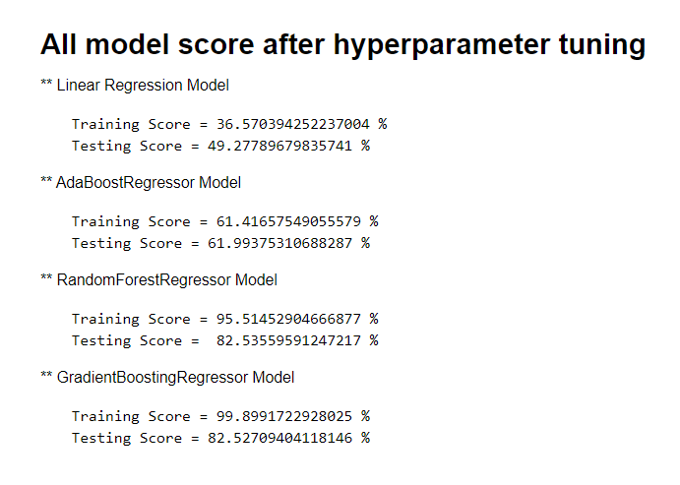
These are 4 Models Which I selected to predict the flight ticket price and after hyperparameter tuning, we Find that Random Forest Regressor Model is the best-suited model and so selecting Random Forest Regressor Model.

Slide 15
CONCLUSION
So from above all 4 model scores, we observe Random Forest Regressor Model is best Suited model for this particular model as the training score is 95.51452904666877 % and the testing score is 82.53559591247217 % thus saving this model.

